Slide 1

Methods for Causal Inference in Educational Research
January/February 2022
Isa Steinmann

Slide 2
Overview
Getting to know each other
Workshop aims
Formalities and schedule
Assignment requirements
Introduction to causal inference

Slide 3



Getting to know each other
https://www.uv.uio.no/cemo/english/people/aca/isast/
https://www.uv.uio.no/cemo/english/people/aca/josemar/index.html

Slide 4
Workshop aims
This workshop aims to
communicate theoretical knowledge about causal and non-causal inference,
illustrate methods for causal inference from experimental and observational data, and
exemplify hands-on applications of the methods in R.

Slide 5
Workshop aims
After a successful completion of the course, the students
have a deep understanding of the potential outcome framework,
have a broad knowledge about the assumptions, prerequisites, and procedures of randomized trials, regression models, regression discontinuity designs, differences-in-differences approaches, and instrumental variable approaches,
can critically read and interpret results of causal inference studies,
can apply methodological peculiarities of the causal inference methods in own analyses, and
can develop own causal inference research questions and approaches.

Slide 6
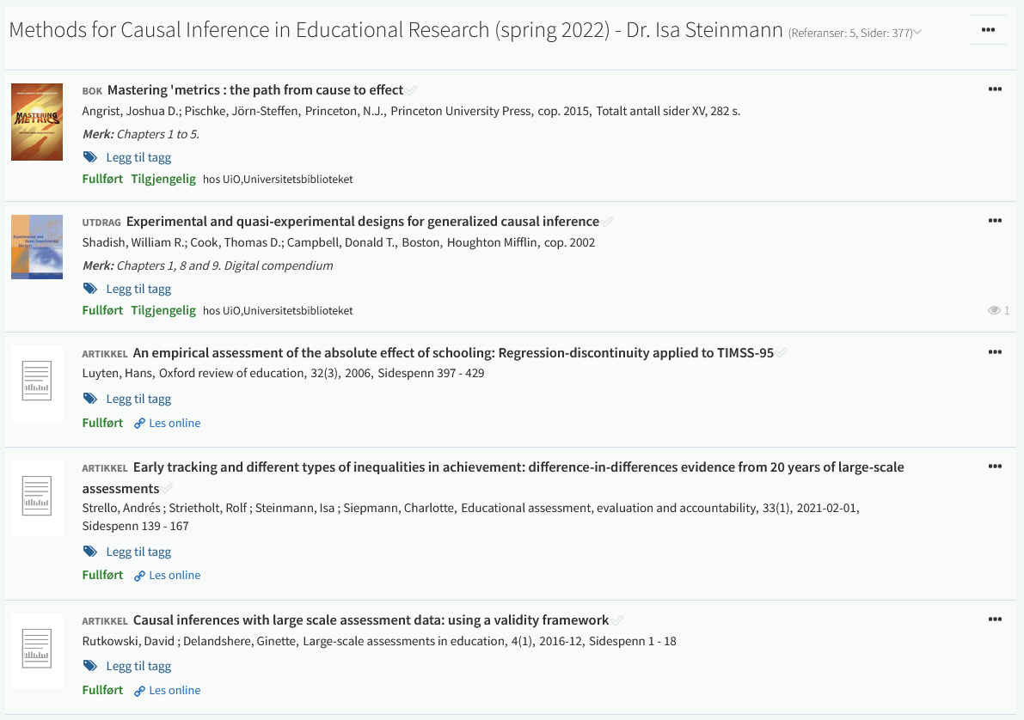
Formalities and schedule
Required Readings
Before each session, read one book chapter or empirical study
Leganto
Slides and Materials
Uploaded to Canvas
All sessions take place in Forskningsparken Basis 314

Slide 7
Formalities and schedule
1 | Introduction Time: 17 January 2022, 12:15-14:00h Main instructor: Isa Steinmann Required reading: Shadish, Cook, & Campbell (2002), chapter 1
2 | Designing Experiments Time: 20 January 2022, 12:15-14:00h Main instructor: Isa Steinmann Required reading: Shadish, Cook, & Campbell (2002), chapter 8
3 | Randomized Trials I Time: 24 January 2022, 12:15-14:00h Main instructor: José Manuel Arencibia Alemán Required reading: Angrist & Pischke (2015), chapter 1
4 | Randomized Trials II Time: 26 January 2022, 12:15-14:00h Main instructor: José Manuel Arencibia Alemán Required reading: Shadish, Cook, & Campbell (2002), chapter 9

Slide 8
Formalities and schedule
5 | Regression Models Time: 31 January 2022, 12:15-14:00h Main instructor: Isa Steinmann Required reading: Angrist & Pischke (2015), chapter 2
6 | Further Control Strategies Time: 03 February 2022, 12:15-14:00h Main instructor: Isa Steinmann Required reading: -
7 | Instrumental Variable Approaches Time: 07 February 2022, 12:15-14:00h Main instructor: José Manuel Arencibia Alemán Required reading: Angrist & Pischke (2015), chapter 3
8 | Regression Discontinuity Designs I Time: 10 February 2022, 12:15-14:00h Main instructor: José Manuel Arencibia Alemán Required reading: Angrist & Pischke (2015), chapter 4

Slide 9
Formalities and schedule
9 | Regression Discontinuity Designs II Time: 14 February 2022, 12:15-14:00h Main instructor: Isa Steinmann Required reading: Luyten (2006)
10 | Differences-in-Differences Designs I Time: 17 February 2022, 12:15-14:00h Main instructor: Isa Steinmann Required reading: Angrist & Pischke (2015), chapter 5
11 | Differences-in-Differences Designs II Time: 21 February 2022, 12:15-14:00h Main instructor: Isa Steinmann Required reading: Strello, Strietholt, Steinmann, & Siepmann (2021)
12 | Lessons Learned and Closing Time: 23 February 2022, 12:15-14:00h Main instructor: Isa Steinmann Required reading: Rutkowski & Delandshere (2016)

Slide 10
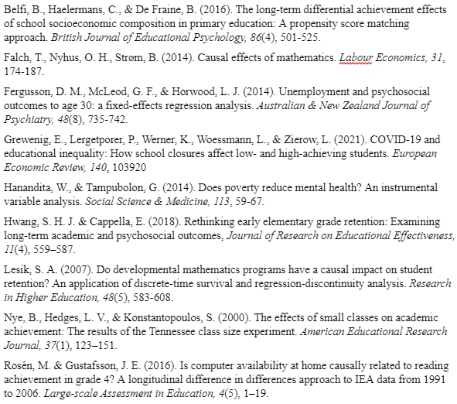
Assignment requirements
Written assignment has to be submitted by 20 April 2022
Task is to discuss three published empirical articles which use methods for causal inference from non-experimental data
Three articles must be chosen from list

Slide 11
Assignment requirements
For each study, the report contains:
Summary of the background and motivation of the study (i.e., why was the study conducted, what was the theoretical background, what did the literature review show)
The identification of the causal question investigated in the study (i.e., what are treatment, outcome, and assumed causal mechanism)
Critical discussion of the causal identification approach against the design principles of the respective causal inference method (i.e., what was the statistical approach, in how far were assumptions of the methods met)
Critical summary of the findings of the study (i.e., what were the findings that directly relate to the research question, what were important other findings)
Concluding discussion about the extent to which the causal question was appropriately answered by the study (i.e., were the statistical conclusions valid, were the conclusions internally and externally valid, are there other explanations for the findings, which limitations were and were not discussed by the authors)
Recommendation on how this or future studies could be improved

Slide 12
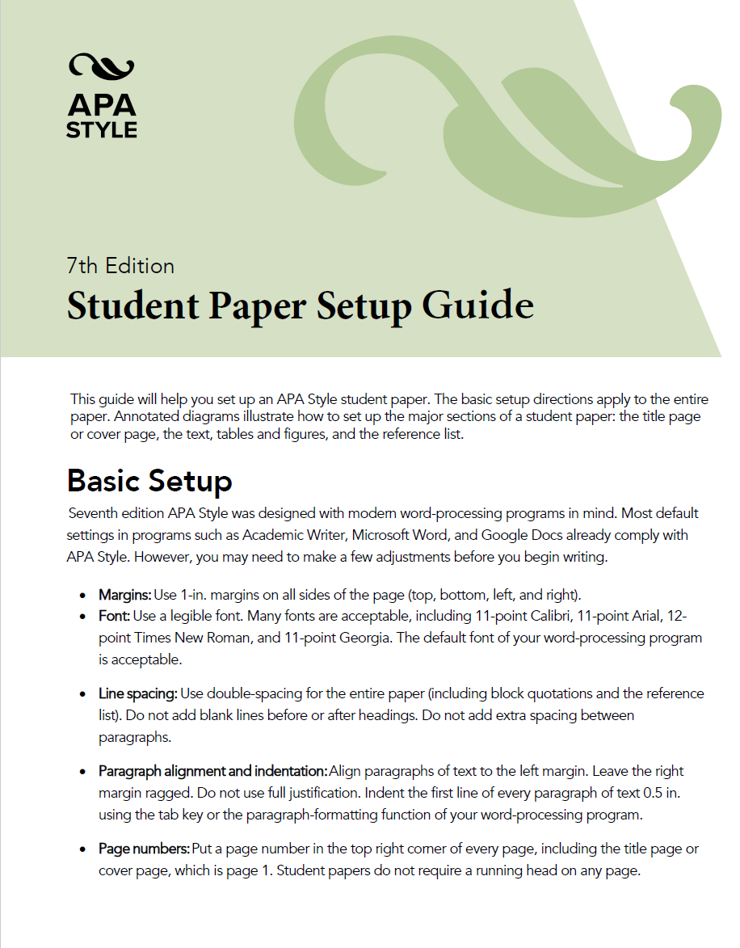
Assignment requirements
The written assignment will be evaluated (pass vs. fail) against following criteria:
Structure: The overall report contains a title page and 3 reports on empirical studies from the list below. The 3 reports contain the subsections (1) background, (2) research question, (3) methods, (4) findings, (5) discussion, and (6) literature list.
Scope: Each of the three reports must be limited to 4-5 pages. The overall report is therefore limited to 12-15 pages in addition to the title page.
Readability: The text is in correct and clear, scientific English. Sections have appropriate headings and all abbreviations are introduced.
Format: The format follows the APA standard (see https://apastyle.apa.org/instructional-aids/student-paper-setup-guide.pdf)
File format: The written assignment is submitted as one PDF.

Slide 13
Assignment requirements
The written assignment will be evaluated (pass vs. fail) against following criteria:
Structure: The overall report contains a title page and 3 reports on empirical studies from the list below. The 3 reports contain the subsections (1) background, (2) research question, (3) methods, (4) findings, (5) discussion, and (6) literature list.
Scope: Each of the three reports must be limited to 4-5 pages. The overall report is therefore limited to 12-15 pages in addition to the title page.
Readability: The text is in correct and clear, scientific English. Sections have appropriate headings and all abbreviations are introduced.
Format: The format follows the APA standard (see https://apastyle.apa.org/instructional-aids/student-paper-setup-guide.pdf)
File format: The written assignment is submitted as one PDF.
Written assignment is failed if it does not follow the above-mentioned criteria for structure, scope, readability, format, and file format or if it is not submitted in time. Written assignment is failed if it misrepresents the empirical studies or methodological approaches.

Slide 14

Questions so far?

Slide 15
Introduction to causal inference
What is the causal effect of something on something else?
“Experimentation is as old as humanity itself” (p. 26)
Experiments are central aspect of life, science, and innovation
What happens if I eat this?
What happens if I mix these things?
What happens if I use this tool instead of another?
…
Experiments aim to
Demonstrate a known truth
Examine if a hypothesis holds
Determine efficacy of something previously untried
Shadish, Cook, & Campbell, 2002

Slide 16
Introduction to causal inference
Many different definitions and philosophical/theoretical underpinnings
Cause:
can be insufficient in itself (i.e., require additional conditions)
can be one of different causes that would lead to the same effect
is usually context-dependent
usually only increases probability of an effect (i.e., not deterministic)
Effect:
has to be compared against counterfactual (i.e., what would have happened otherwise?)
Causal relationship/mechanism (can we be sure that cause and effect are indeed related?):
cause has to come before effect
cause has to be related to the effect
there is no alternative explanation for the association
Campfire example
Shadish, Cook, & Campbell, 2002

Slide 17
Rubin’s potential outcome framework
D
Y
Cause-and-effect questions imply that D causes a change in Y
Treatment D
if binary, D=0 (no treatment/control/comparison) and D=1 (treatment)
before outcome
Outcome Y
if there is a causal effect, Y_{D=0} and Y_{D=1} differ
→ What does that mean?
Rubin, 1974

Slide 18
Rubin’s potential outcome framework
with D=0
and Y_{D=0}
with D=1
and Y_{D=1}
The impossible, ideal experiment
In parallel universes where the same individual is once treated and once not treated, nothing differs except the treatment and outcome (ceteris paribus/other things equal)
What would have been (potential outcome or counterfactual)?
Then, the difference Y_{D=1} - Y_{D=0} reflects the causal effect of D on Y
Rubin, 1974

Slide 19
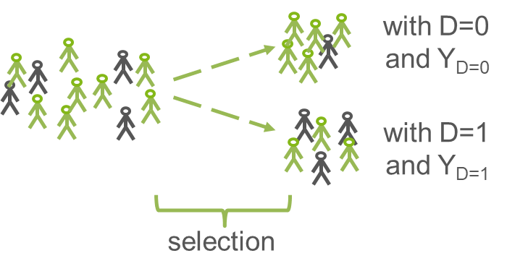
Rubin’s potential outcome framework
In reality, we need to compare groups
E[Y_{1,i}|D_{i}=1] - E[Y_{0,i}|D_{i}=0]
Difference between treatment and control/comparison group only reflects effect of D, if other things are equal (ceteris paribus)
If selection into groups relates to something that is also relevant for the outcome, difference between groups reflects causal effect and selection bias
Rubin, 1974

Slide 20


Rubin’s potential outcome framework
selection
bias!
In other words, selection bias means that we compare apples and oranges!

Slide 21
Rubin’s potential outcome framework
selection
bias!
Example:
Negative correlation between private tutoring and mathematics achievement

Slide 22
Rubin’s potential outcome framework
selection
bias!
Example:
Positive correlation between teacher training program and job satisfaction

Slide 23
Questions so far?

Slide 24
Correlation ≠ Causation (!)
Why does correlation not prove causation?
maybe we don’t know which variable came first (e.g., reverse causation)
maybe, there is no true association, at all (e.g., spurious correlation)
maybe, there are other explanations (e.g., third-variable effect, confounding, selection bias)
D
Y
D
Y
D
Y
Campfire example
Z

Slide 25
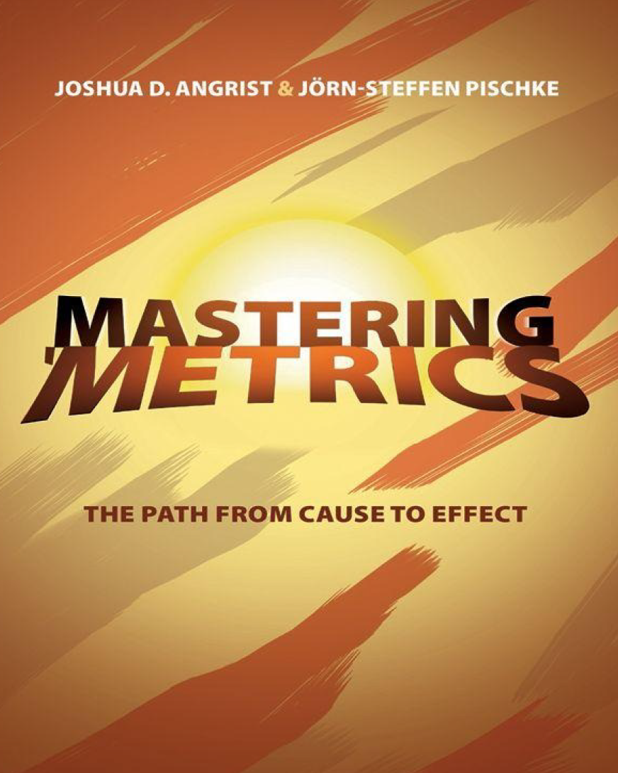

https://www.masteringmetrics.com/
https://www.nobelprize.org/prizes/economic-sciences/2021/summary/

Slide 26

https://www.youtube.com/watch?v=iPBV3BlV7jk
Notes:
6 min

Slide 27
Questions so far?

Slide 28

Take-away messages
Causal inference possible if
plausible causal mechanism
treatment before outcome
comparison with counterfactual
ceteris paribus
Very good counterfactuals and ceteris paribus are difficult to establish
Multiple issues such as selection bias, reverse causation, and third-variable effects prohibit causal inference

Slide 29
Required reading for next week
1 | Introduction Time: 17 January 2022, 12:15-14:00h Main instructor: Isa Steinmann Required reading: Shadish, Cook, & Campbell (2002), chapter 1
2 | Designing Experiments Time: 20 January 2022, 12:15-14:00h Main instructor: Isa Steinmann Required reading: Shadish, Cook, & Campbell (2002), chapter 8
3 | Randomized Trials I Time: 24 January 2022, 12:15-14:00h Main instructor: José Manuel Arencibia Aleman Required reading: Angrist & Pischke (2015), chapter 1
4 | Randomized Trials II Time: 26 January 2022, 12:15-14:00h Main instructor: José Manuel Arencibia Aleman Required reading: Shadish, Cook, & Campbell (2002), chapter 9

Slide 30
Thanks for your attention!
Isa Steinmann
isa.steinmann@cemo.uio.no

Slide 31
References
Angrist, J. & Pischke, J.-S. (2015). Mastering `Metrics: The Path from Cause to Effect. Princeton University Press
Rubin, D. B. (1974). Estimating causal effects of treatments in randomized and nonrandomized studies. Journal of Educational Psychology, 66(5), 688–701
Shadish, W. R., Cook, T. D., & Campbell, D. T. (2002). Experimental and quasi-experimental designs for generalized causal inference. Mifflin and Company

